Slide 1
Name | MUNDURI LAKSHMI SRUJANA
SkillsBuild Email ID | 21b01a12b7@svecw.edu.in
College Name | Shri Vishnu Engineering College for women
Internship Domain | Artificial Intelligence
Start Date | 12th June, 2023
End Date | 24th July, 2023

Slide 2
MENTAL FITNESS
TRACKER

Slide 3

PROBLEM STATEMENT
Mental health is a critical component of overall health and well-being, yet it is often neglected. Mental fitness trackers can help people track their mental health and well-being over time, but there are currently no trackers that are comprehensive, user-friendly, and affordable

Slide 4
AGENDA
Track your mood, sleep, stress levels, and other factors that can impact mental health.
Get personalized tips and exercises to improve your mental health.
Protect your privacy and security.

Slide 5
PROJECT OVERVIEW
Mental fitness: The ability to cope with stress, maintain positive emotions, and build resilience.
Importance of mental fitness: It can help us to cope with stress and difficult emotions, maintain positive emotions, build resilience in the face of challenges, and improve our overall health and well-being.
How a mental fitness tracker can help: It can help us to track our mental health and improve our overall well-being in a number of ways. It can help us to become more aware of our own mental health, identify early signs of mental health problems, monitor our progress over time, and provide us with personalized tips and exercises to improve our mental health.
Features: A mental fitness tracker could include a variety of features to help users track their mental health and improve their overall well-being. These features could include tracking of mood, sleep, stress levels, and other factors that can impact mental health, personalized tips and exercises to improve mental health, and privacy and security features.
Conclusion: A mental fitness tracker could be a valuable tool for helping people to improve their mental health. It is important to note that a mental fitness tracker is not a substitute for professional help, but it can be a helpful tool in addition to professional treatment

Slide 6
WHO ARE THE END USERS
General Users: Anyone who wants to maintain good mental health and track their emotional and cognitive states
Individuals with Mental Health Concerns: People who have diagnosed mental health conditions, such as anxiety, depression, or bipolar disorder, and want to monitor their symptoms and progress.
Stress Management Seekers: Individuals looking for tools to manage and reduce stress levels in their daily lives
Students and Professionals: Students facing academic stress or professionals dealing with work-related pressure who want to monitor their mental health and enhance their coping strategies.
Athletes and Performers: Athletes, dancers, musicians, or performers who need to manage performance anxiety and track their mental states to optimize their performance.
Therapists and Mental Health Professionals: Mental health practitioners who can use the tracker as an additional resource to gather data and insights about their clients' mental well-being.

Slide 7
SOLUTION
Tracking and Monitoring: The mental fitness tracker offers tools and functionalities to track and monitor various aspects of mental health, including mood, stress levels, sleep patterns, and activity levels. It provides a holistic view of mental well-being, allowing users to gain insights into their mental states and identify areas for improvement.
Personalized Recommendations: These recommendations can include stress management techniques, relaxation exercises, sleep hygiene tips, or activities tailored to the individual's needs and goals. The solution provides actionable guidance for improving mental health.
Goal Setting and Progress Tracking: Users can set mental health goals and track their progress over time. The mental fitness tracker allows individuals to establish achievable targets, monitor their advancements, and celebrate milestones, providing motivation and a sense of accomplishment.
Education and Resources: The solution may include educational content, articles, or resources related to mental health and well-being. Users can access information on self-care practices, stress reduction strategies, mindfulness techniques, and other resources to enhance their mental fitness journey.
Integration with Professional Support: The mental fitness tracker can integrate with mental health professionals, providing access to resources, helplines, or seamless connectivity to teletherapy platforms. This integration bridges the gap between self-monitoring and professional support, ensuring users can seek help when needed.

Slide 8
VALUE PREPOSITION
Proactive Mental Health Management: It providing tools for tracking, insights, and recommendations, the solution enables users to proactively address their mental well-being and make informed decisions to improve their overall quality of life.
Increased Self-Awareness: Through continuous tracking and monitoring, the mental fitness tracker enhances self-awareness. Users gain insights into their mood patterns, stress triggers, and sleep quality, enabling them to recognize and understand their emotional states better.
Personalized Support and Guidance: The solution delivers personalized recommendations and resources based on the user's specific needs and goals. By tailoring the guidance to each individual, the mental fitness tracker provides relevant and actionable support, helping users make tangible progress in their mental well-being journey.
Empowerment and Engagement: The mental fitness tracker encourages users to actively engage in self-care and mental health management. By setting goals, tracking progress, and celebrating achievements, the solution empowers individuals, promoting a sense of control, motivation, and accountability in their pursuit of better mental health.
Convenience and Accessibility: The digital nature of the mental fitness tracker makes it easily accessible to users at their convenience. It can be accessed through smartphones, tablets, or web platforms, allowing individuals to monitor and engage with their mental well-being anytime, anywhere.

Slide 9
CUSTOM UPDATES IN MENTAL FITNESS TRACKER
Mood tracking: Include a feature where you can record and track your mood throughout the day. You can use a scale or a range of emotions to rate your mood, allowing you to identify patterns and triggers.
Stress level assessment: Develop a feature that enables you to assess and track your stress levels. You can use a rating scale or a visual representation to record your stress levels at different times of the day or in response to specific events.
Goal setting and progress tracking: Allow users to set specific mental health goals and track their progress over time. This can include goals related to meditation, exercise, sleep, self-care, or any other aspect of mental fitness you want to focus on.
Physical health integration: Consider integrating data from fitness trackers or health apps to correlate your mental fitness with physical health metrics. For example, tracking your sleep quality, steps taken, heart rate, or nutrition can provide insights into how they affect your mental well-being.
Community and support: Incorporate features that allow you to connect with a community of like-minded individuals. This can include forums, chat groups, or the ability to share your progress and experiences with others. Peer support can be a valuable aspect of improving mental well-being.

Slide 10
MODELLING
Define the Problem: Clearly define the objectives and goals of the mental fitness tracker. Determine what aspects of mental well-being we want to track and support, such as stress levels, mood, sleep quality, focus, or mindfulness.
Data Collection: Collect relevant data to train and fine-tune our model. This could include self-reported data from users, physiological data (e.g., heart rate, sleep patterns), or behavioral data (e.g., app usage, activities performed). Consider using surveys, questionnaires, or sensor-based technologies to gather the necessary data.
Feature Selection: Identify the features or variables that are most relevant to the mental fitness tracker's goals. These features could be derived from the collected data or external sources. For example, features might include sleep duration, exercise frequency, social interactions, or subjective self-assessments of mood.
Data Preprocessing: Clean, transform, and preprocess the collected data to ensure it is in a suitable format for modeling. This step may involve handling missing data, normalizing or standardizing features, and dealing with outliers or noise.

Slide 11
Model Selection: Choose an appropriate modeling technique that aligns with the objectives of the mental fitness tracker. Common options include regression models, time series analysis, classification models, or deep learning approaches. Consider the specific requirements and characteristics of your data when selecting a model.
Model Training: Splitting our data into training and validation sets. Train your selected model using the training set and optimize its parameters to minimize error or maximize performance. Utilize techniques such as cross-validation or hyperparameter tuning to improve model accuracy.
Evaluation: Evaluating the performance of our trained model using the validation set. Using appropriate metrics based on the specific task, such as accuracy, precision, recall, or mean squared error. Assess the model's performance and determine if it meets the desired criteria.
Deployment and Iteration: Once we have a satisfactory model, integrate it into the mental fitness tracker system. Continuously collect user feedback and iterate on the model as needed to improve its accuracy, usability, and effectiveness. Monitor and analyze the tracker's performance to identify areas for improvement

Slide 12
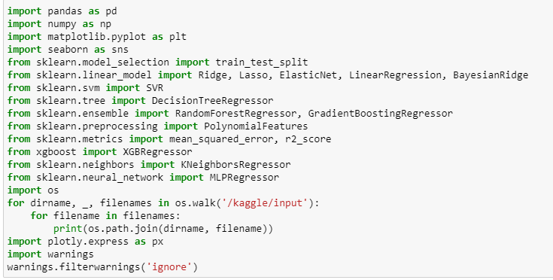
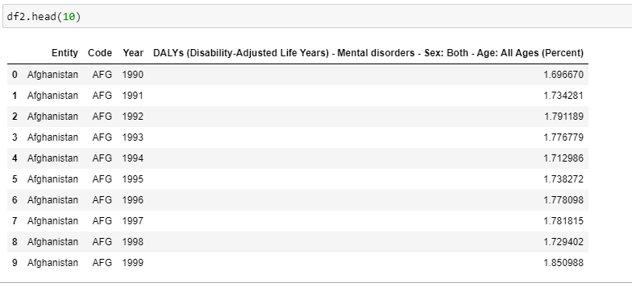
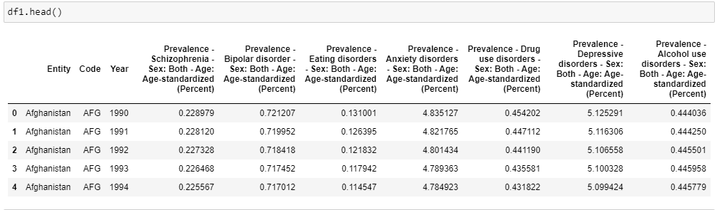
DATA COLLECTION

Slide 13
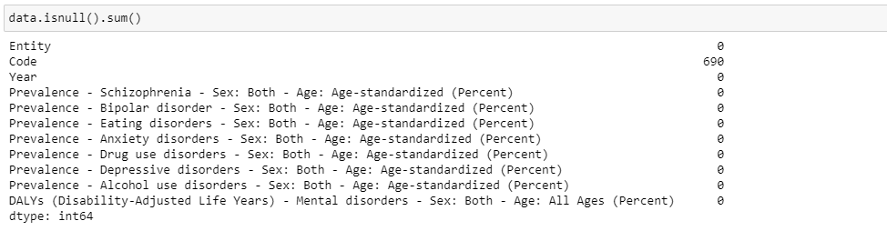
DATA CLEANING

Slide 14
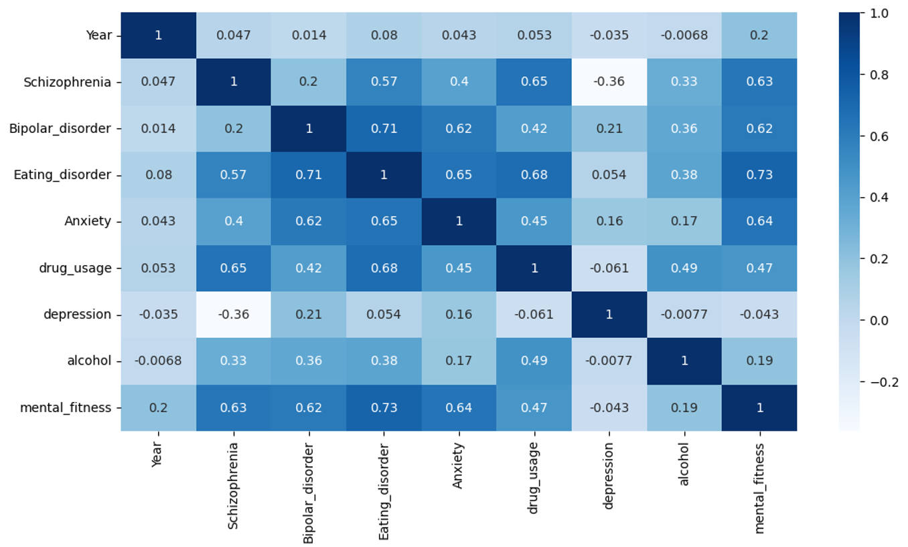
VISUALIZATION

Slide 15
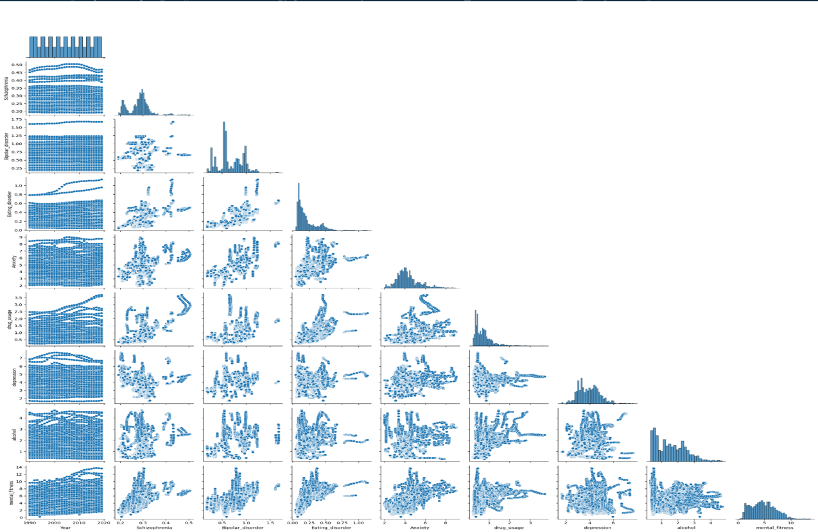
PREPROCESSING

Slide 16
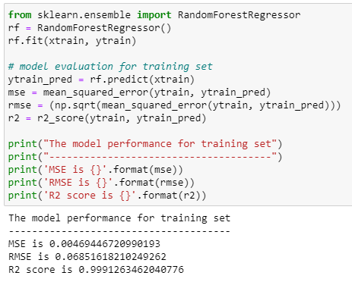
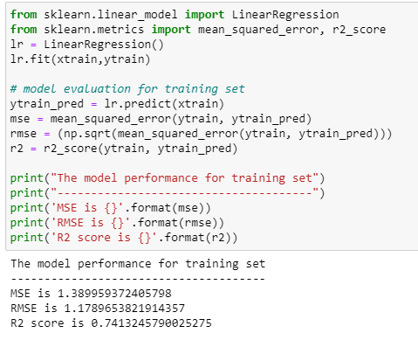
RANDOM FOREST | LINEAR REGRESSION

Slide 17
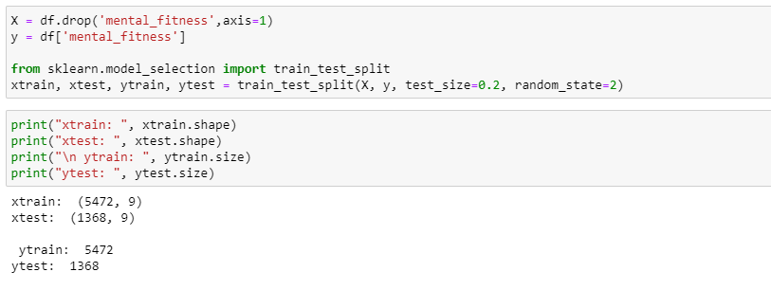
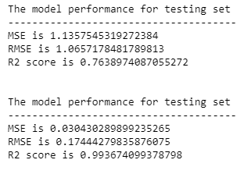
SPLITTING
RESULT

Slide 18
LINKS
https://github.com/Lakshmi-Srujana-Munduri/MENTAL-FITNESS-TRACKER

Slide 19
THANK YOU

